Slide 1
Big Data Management and Analytics
Introduction
Spring 2019
Dr. Latifur Khan

Slide 2
Introduction to Big Data
What is Big Data?
What makes data, “Big” Data?

Slide 3
Big Data Definition
No single standard definition…
“Big Data” is data whose scale, diversity, and complexity require new architecture, techniques, algorithms, and analytics to manage it and extract value and hidden knowledge from it…

Slide 4
Big Data
Big Data are “data sets that are so big they cannot be handled efficiently by common database management systems” (Dasgupta, 2013).
Big Data have volume of 100 terabytes to petabytes, have structured and unstructured formats, and have a constant flow of data (Davenport, 2014).
No single standard definition…

Slide 5


Where Does Big Data Come From?
It’s all happening online – could record every:
Click
Transaction
Fault
Online shopping
…
User Generated Content (Web & Mobile):
Facebook
Instagram
Twitter
News articles
…

Slide 6
Learning Outlines
Upon completion of this lesson, students will be able to:
Motivation
Big Data
Characteristics of Big Data
Introduction to Apache Spark
Spark MLLib
Spark Streaming
Notes:
6

Slide 7
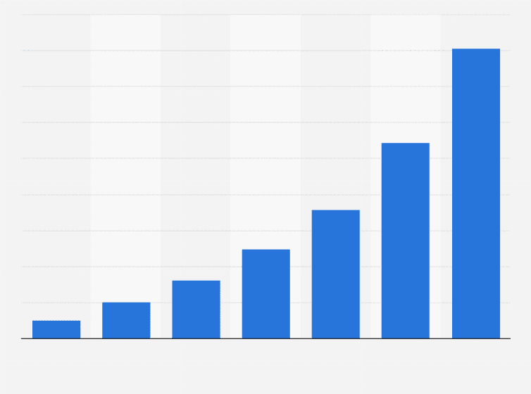


Characteristics of Big Data
Volume
Velocity
Variety

Slide 8


Additional Characteristics of Big Data
Value
Veracity

Slide 9
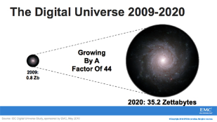
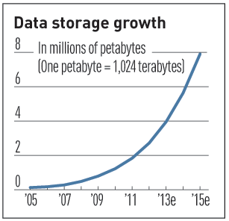

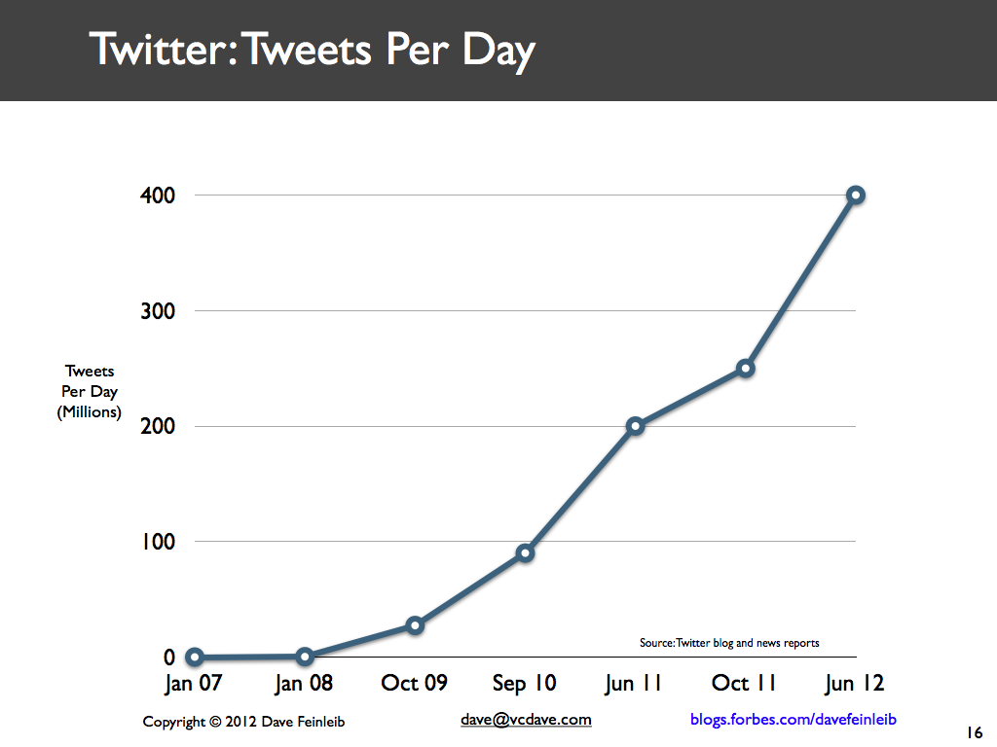
Characteristics of Big Data: 1-Scale (Volume)
Data Volume
44x increase from 2009 2020
From 0.8 zettabytes to 35zb
Data volume is increasing exponentially
Exponential increase in collected/generated data

Slide 10
Characteristics of Big Data: Volume
It relates to the large volume of data: Terabytes or Petabytes
Size, records, transactions or tables
Data volume is increasing exponentially
Today, Facebook ingests 500 terabytes of new data every day.
Boeing 737 will generate 240 terabytes of flight data during a single flight across the US.
The smart phones, the data they create and consume; sensors embedded into everyday objects will soon result in billions of new, constantly-updated data feeds containing environmental, location, and other information, including video.

Slide 11

Characteristics of Big Data: 2-Speed (Velocity)
Data is begin generated fast and need to be processed fast
Online Data Analytics
Late decisions ➔ missing opportunities
Examples
E-Promotions: Based on your current location, your purchase history, what you like ➔ send promotions right now for store next to you
Healthcare monitoring: sensors monitoring your activities and body ➔ any abnormal measurements require immediate reaction

Slide 12
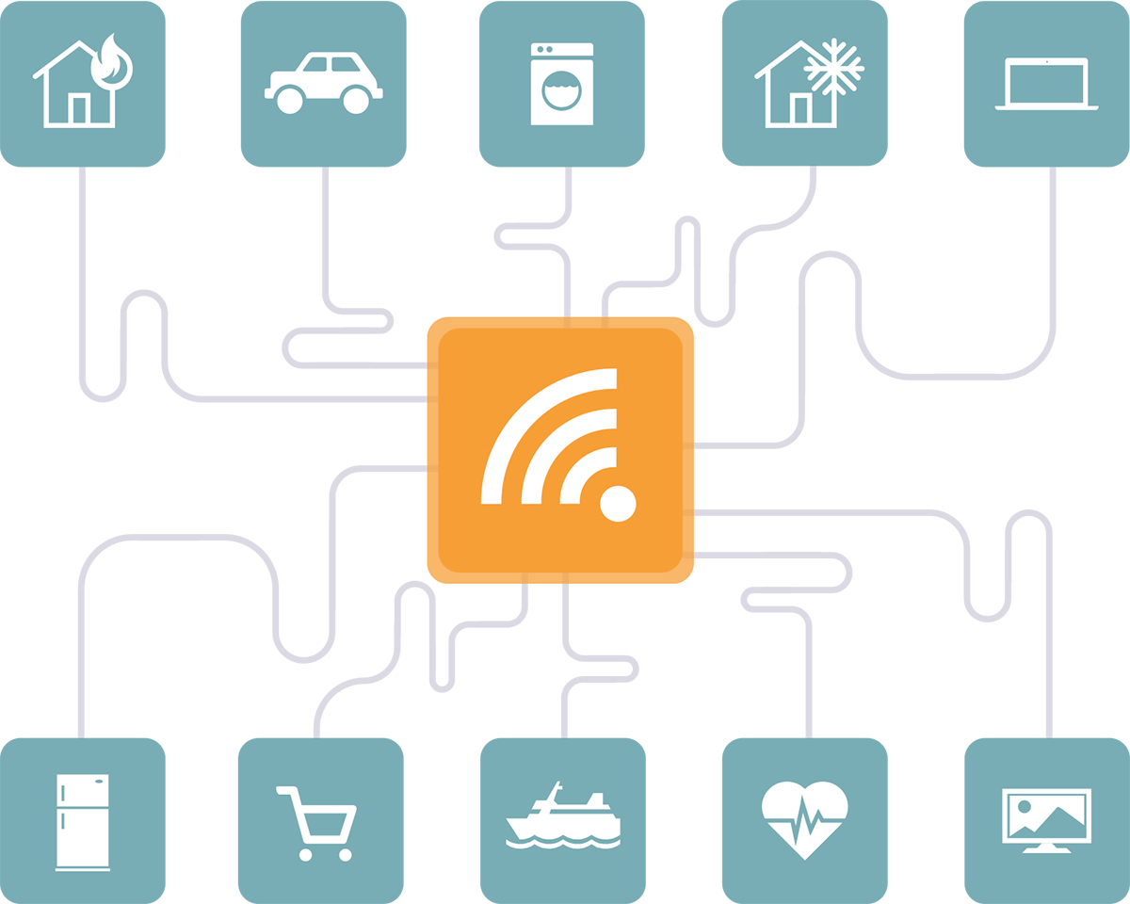


Characteristics of Big Data: Velocity
It relates to the frequency of updates
Clickstreams and ad impressions capture user behavior at millions of events per second
high-frequency stock trading algorithms reflect market changes within microseconds
infrastructure and sensors generate massive log data in realtime
on-line gaming systems support millions of concurrent users, each producing multiple inputs per second.
Sensor Data
Online Game Data
FInancial data

Slide 13
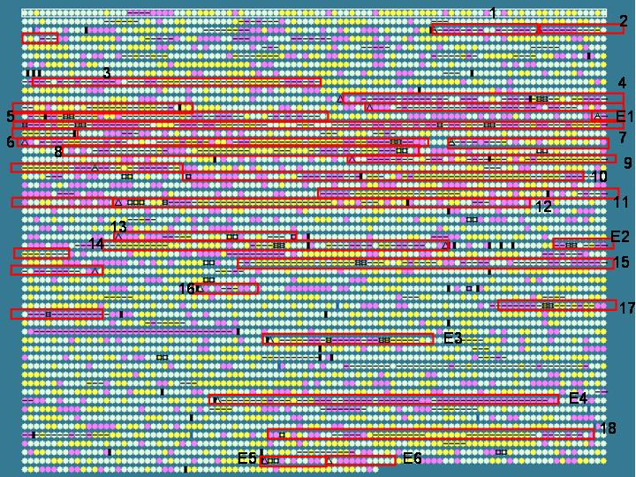
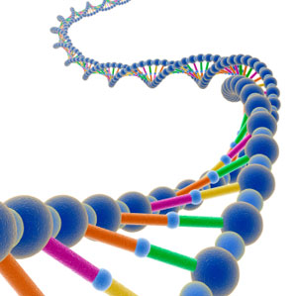
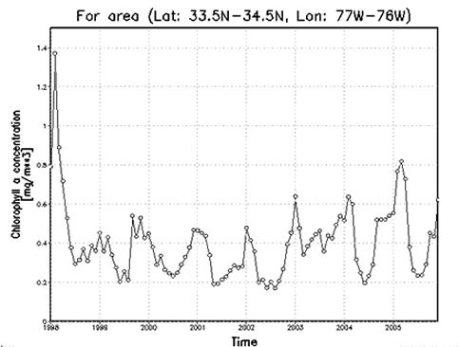

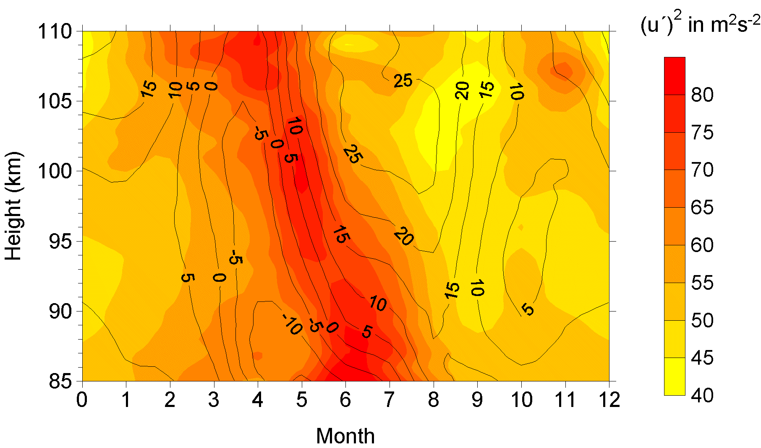

Characteristics of Big Data: 3-Complexity (Variety)
Various formats, types, and structures
Text, numerical, images, audio, video, sequences, time series, social media data, multi-dim arrays, etc…
Static data vs. streaming data
A single application can be generating/collecting many types of data
To extract knowledge➔ all these types of data need to linked together

Slide 14

Characteristics of Big Data: Variety
It relates to the number and type of data sources
Relational Data (Tables/Transaction/Legacy Data)
Text Data (Web)
Semi-structured Data (XML)
Graph Data
Social Network, Semantic Web (RDF), …
Streaming Data
You can only scan the data once
A single application can be generating/collecting many types of data
ex. Sensors
Big Public Data (online, weather, finance, etc)

Slide 15
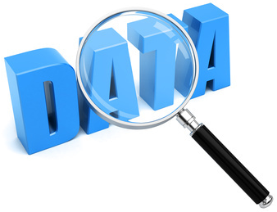
Characteristics of Big Data: 4 V -Veracity
It relates to the messiness or trustworthiness of the data.
With many forms of big data, quality and accuracy are less controllable but big data and analytics technology now allows us to work with these type of data.
Veracity arises due to the high volume of data that brings incompleteness and inconsistency.
Uncertainty of Data
???

Slide 16
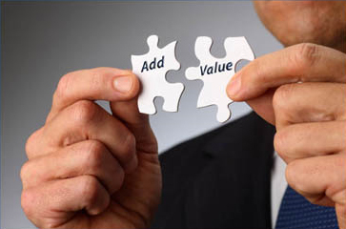
Characteristics of Big Data: 5 V --Value
It relates to the added value for companies/ businesses.
The most important part of a big data initiative is to understand the costs and benefits of collecting and analyzing the data to ensure that eventually the data that is reaped can be monetized.

Slide 17
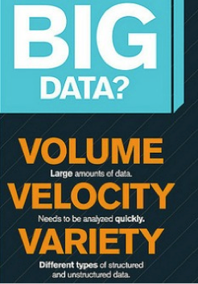

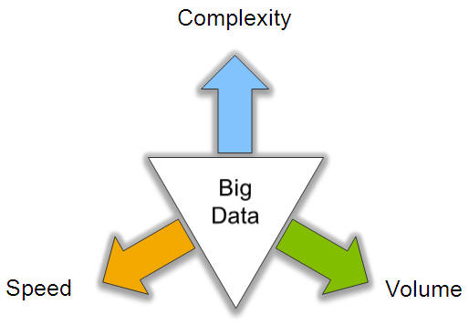
Big Data: 3V’s

Slide 18
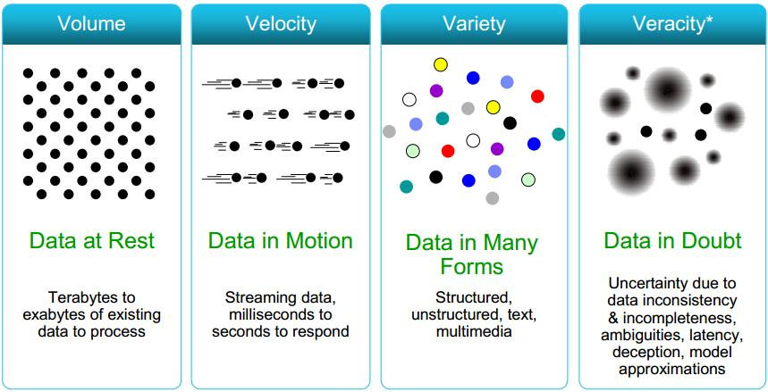
Some Make it 4V’s

Slide 19
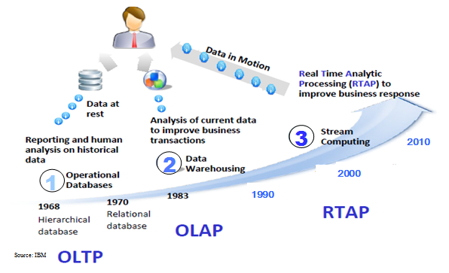
Harnessing Big Data
OLTP: Online Transaction Processing (DBMSs)
OLAP: Online Analytical Processing (Data Warehousing)
RTAP: Real-Time Analytics Processing (Big Data Architecture & technology)

Slide 20
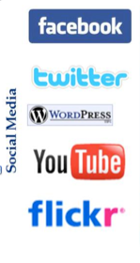
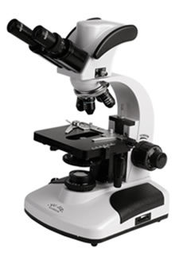

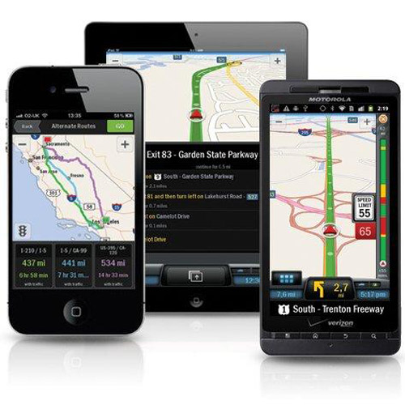
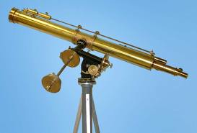
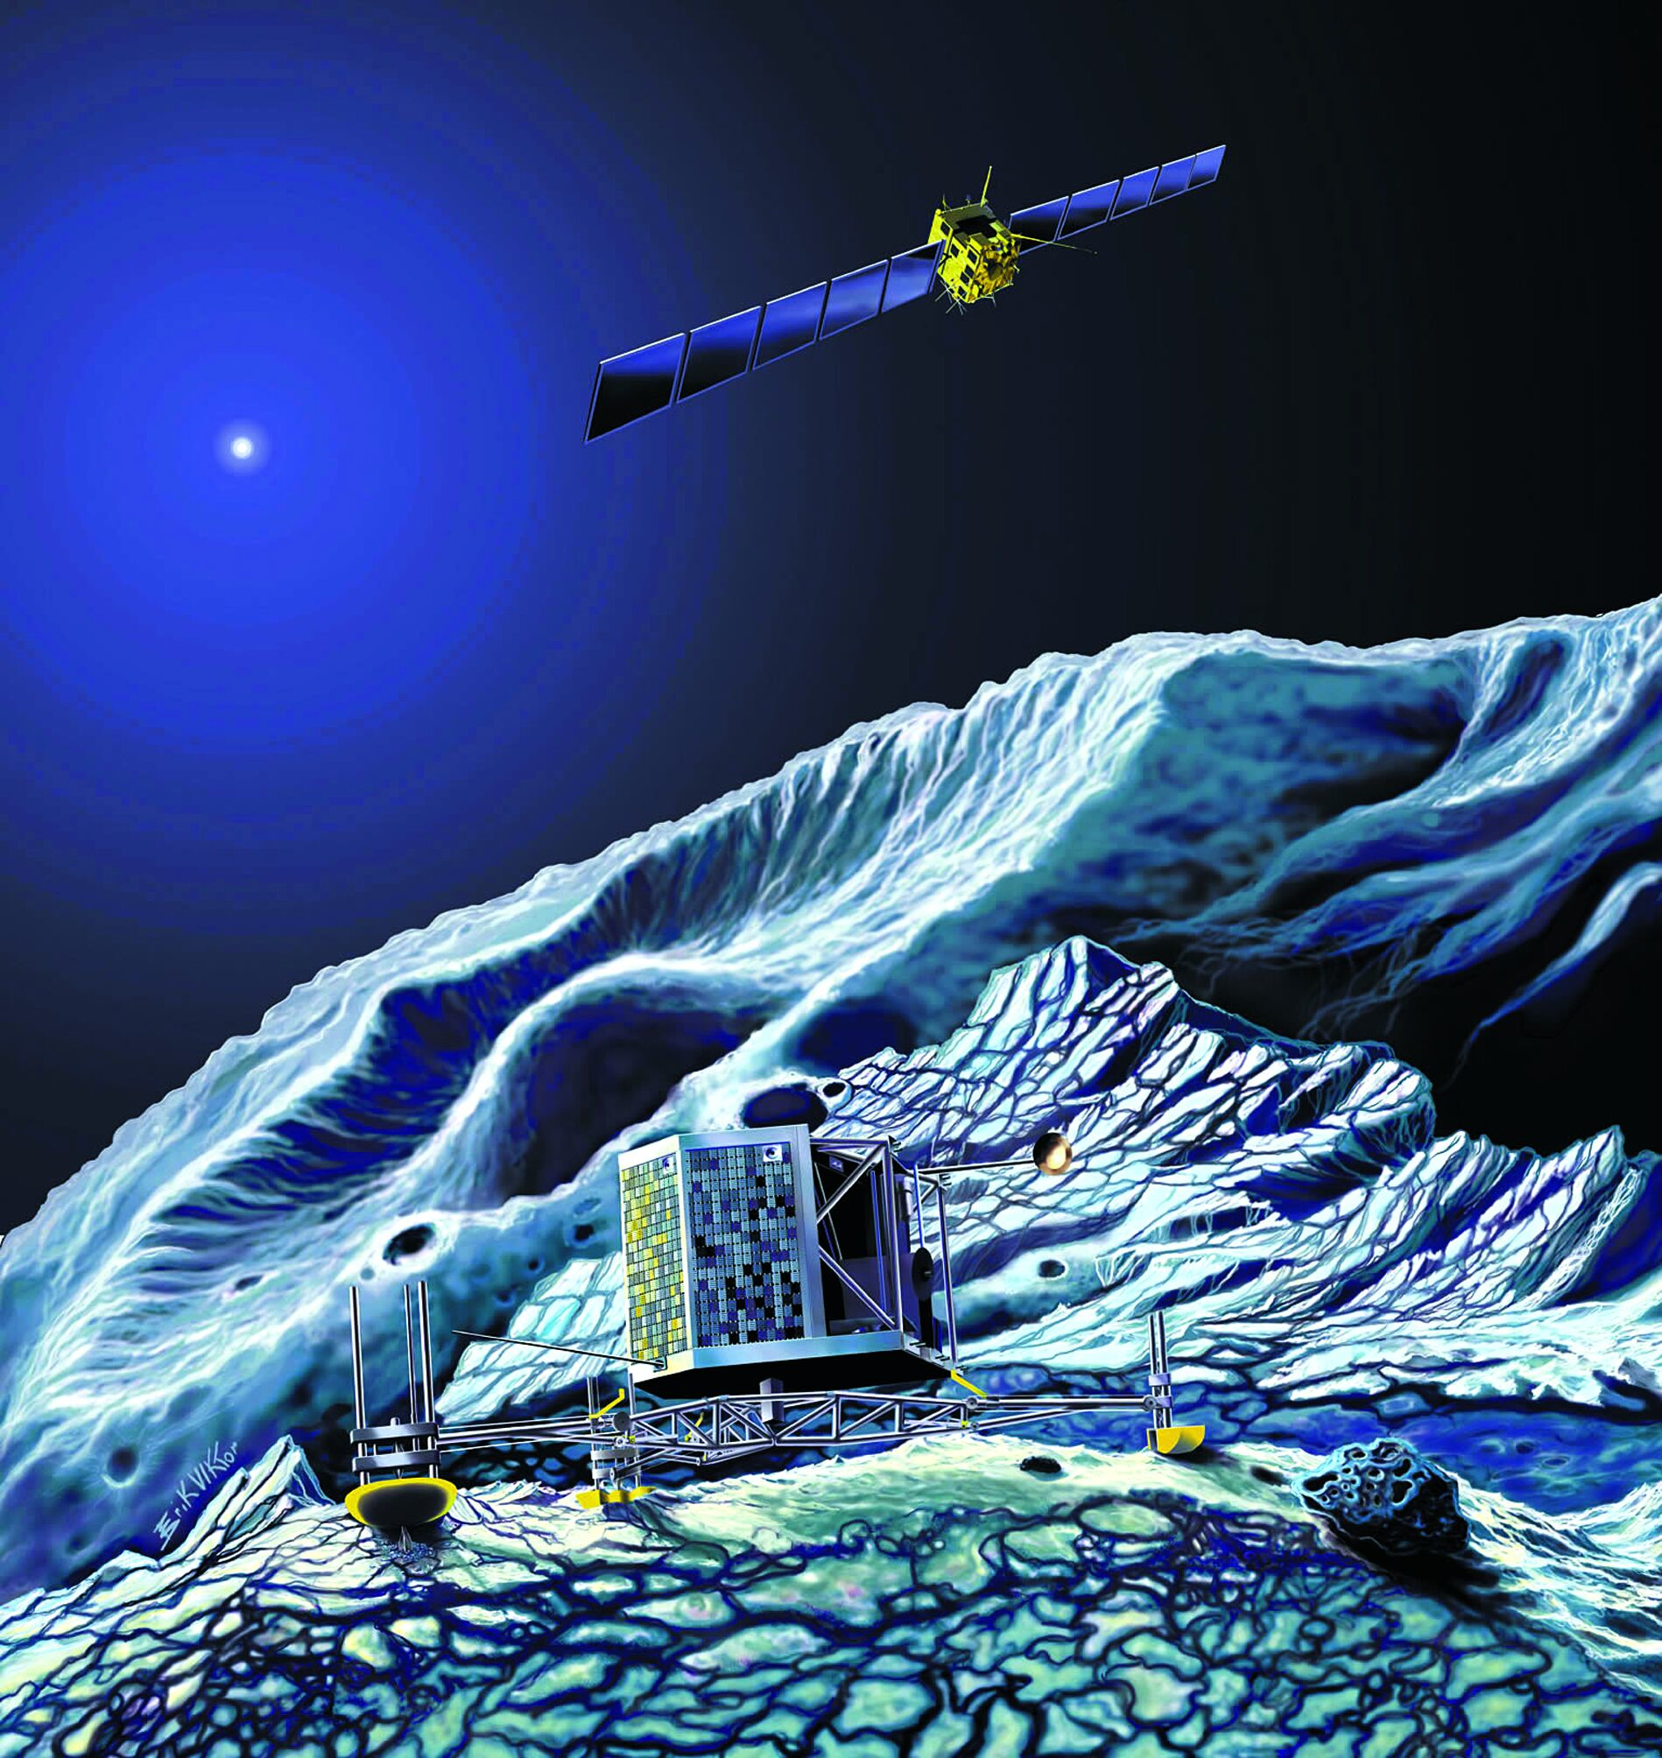
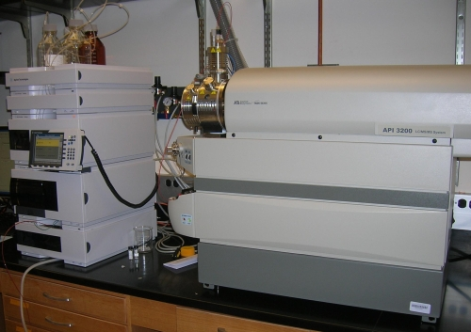
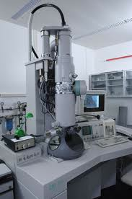
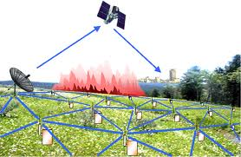
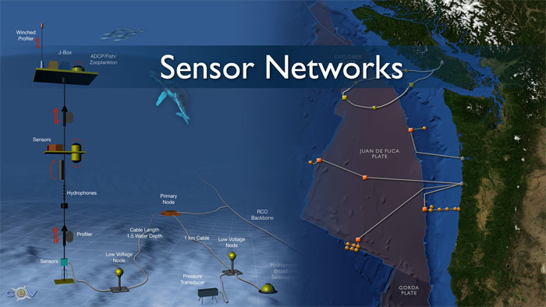
Who’s Generating Big Data
Mobile devices
(tracking all objects all the time)
Social media and networks
(all of us are generating data)
Scientific instruments
(collecting all sorts of data)
Sensor technology and networks
(measuring all kinds of data)
The progress and innovation is no longer hindered by the ability to collect data
But, by the ability to manage, analyze, summarize, visualize, and discover knowledge from the collected data in a timely manner and in a scalable fashion

Slide 21
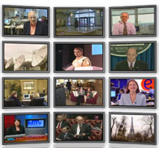



The Model Has Changed…
The Model of Generating/Consuming Data has Changed
Old Model: Few companies are generating data, all others are consuming data
New Model: all of us are generating data, and all of us are consuming data

Slide 22
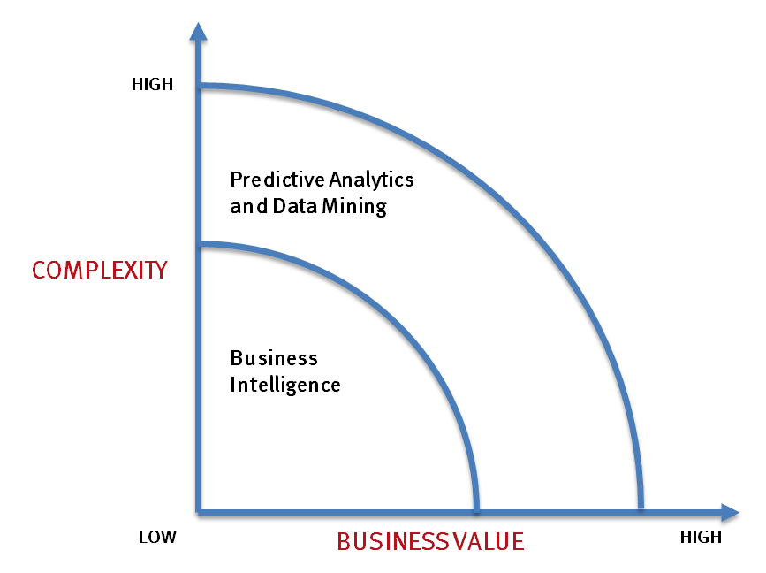
What’s driving Big Data
- Optimizations and predictive analytics
- Complex statistical analysis
- All types of data, and many sources
- Very large datasets
- More of a real-time
- Ad-hoc querying and reporting
- Data mining techniques
- Structured data, typical sources
- Small to mid-size datasets

Slide 23
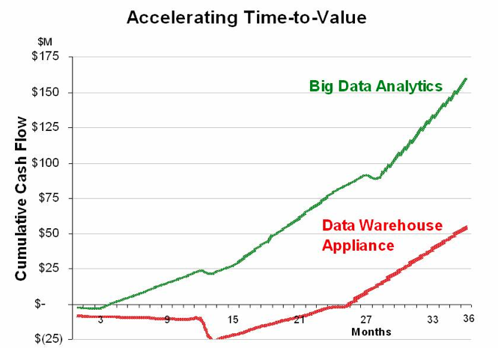
Value of Big Data Analytics
Big data is more real-time in nature than traditional DW applications
Traditional DW architectures (e.g. Exadata, Teradata) are not well-suited for big data apps
Shared nothing, massively parallel processing, scale out architectures are well-suited for big data apps

Slide 24
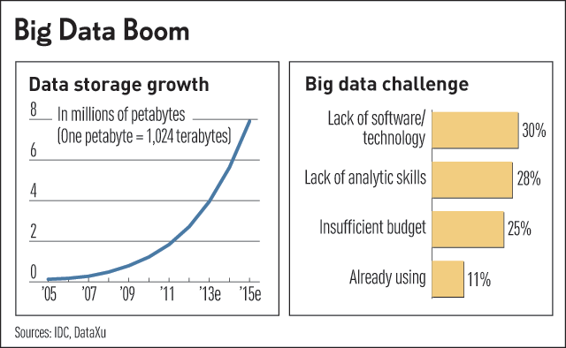
Challenges in Handling Big Data
The Bottleneck is in technology
New architecture, algorithms, techniques are needed
Also in technical skills
Experts in using the new technology and dealing with big data

Slide 25
What Technology Do We Have
For Big Data ??

Slide 26
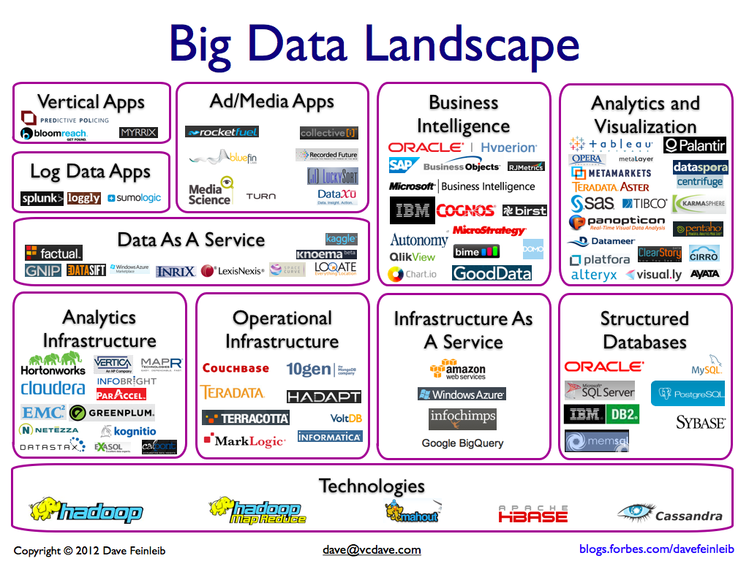

Slide 27
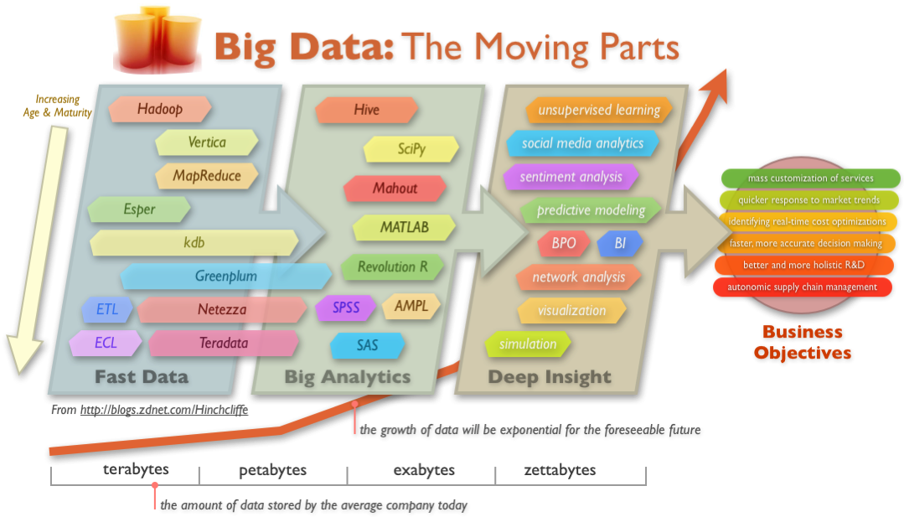
Big Data Technology

Slide 28
What You Will Learn…
We focus on Hadoop/MapReduce technology, NoSQL (key-Value), BigTable, Cassandra, SPARK, Stream…
Learn the platform (how it is designed and works)
How big data are managed in a scalable, efficient way
Learn writing Hadoop jobs/SPARK in different languages
Programming Languages: Java, Python, Scala
High-Level Languages: Hive
Learn advanced analytics tools on top of Hadoop
Mlib and Scikit Learning
Applications: Recommendations
Text Data Processing

